Slide 1



PROJECT COST MANAGEMENT
LECTURE # 9

Slide 2



Slide 3
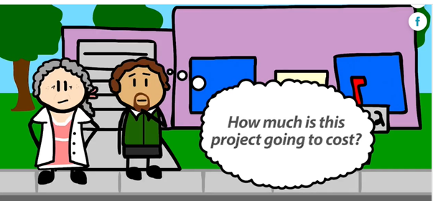

Slide 4
What is Project cost?
What is Project Cost?
The project cost is a cost required to procure all the needed products, services and resources to deliver the project successfully.
Example: In an example of a construction project, the cost estimation starts from land acquisition cost, construction cost, materials cost, administration cost, labor cost and other direct and indirect costs.

Slide 5
Project Cost Management
What is Project Cost Management?
Project cost management is all of the activities used to estimate, allocate and control cost to ensure a project stays on budget.

Slide 6
IMPORTANCE
After all, if you can’t definitively lay out how much a project will cost, how will you be able to quantify if you’ve made any money?
Without a detailed budget, you cannot effectively map out the resources needed for your project.
Project success is decided by how well the project cost has been handled in the project.

Slide 7
BENEFITS
By implementing efficient cost management practices, project managers can:
Set clear expectations with stakeholders
Control scope creep due to transparencies established with the customer
Track progress and respond with corrective action at a quick pace
Maintain expected margin, increase ROI, and avoid losing money on the project
Generate data to benchmark for future projects and track long-term cost trends

Slide 8

TYPE OF RESERVES

Slide 9
CONTIGENCY RESERVE
Contingency reserves are allowances for unplanned but potentially required changes that can result from realized risks identified in the risk register or past project.
Some of the items, conditions, or events for which the state, occurrence, and/or effect is uncertain include, but are not limited to, planning and estimating errors and omissions, minor price fluctuations (other than general escalation), design developments and changes within the scope, and variations in market and environmental conditions”.

Slide 10
CONTIGENCY RESERVE
Contingency usually excludes:
Major scope changes such as changes in end product specification, capacities, building sizes, and location of the asset or project;
Extraordinary events such as major strikes and natural disasters;
Management reserves; and
Escalation and currency effects.
Contingency is the cost or time allowance that is used to manage identified risks or “known-unknown”. Contingency is not a random allowance, it is an estimated allowance based on various assessment techniques

Slide 11
MANGEMENT RESERVE
Management reserves, on the other hand, are budgets reserved for unplanned changes to project scope and cost.
Management Reserve” is the cost or time allowance that is used to manage the unidentified risks or “unknown-unknown”.
“Management Reserve” is not an estimated allowance but a random figure by management, which is usually assessed according to the organization’s policy/risk appetite/past performance/etc..
Accordingly, the “Management Reserve” is not in the Performance Measurement Baseline (PMB) but is a part of the Project Budget Base (PBB)

Slide 12
TYPE OF COST –
DIRECT AND INDIRECT COST
Costs associated with the project itself.
Examples of direct costs include fixed labor, materials, and equipment
Indirect Costs incurred by the organization at large. Indirect costs are oftentimes called overhead and they do not vary based on the project. he indirect cost is the amount of money spent to support indirect completion of the project Examples of indirect costs include building rent, administrative costs, electric power, and general operational fees.

Slide 13
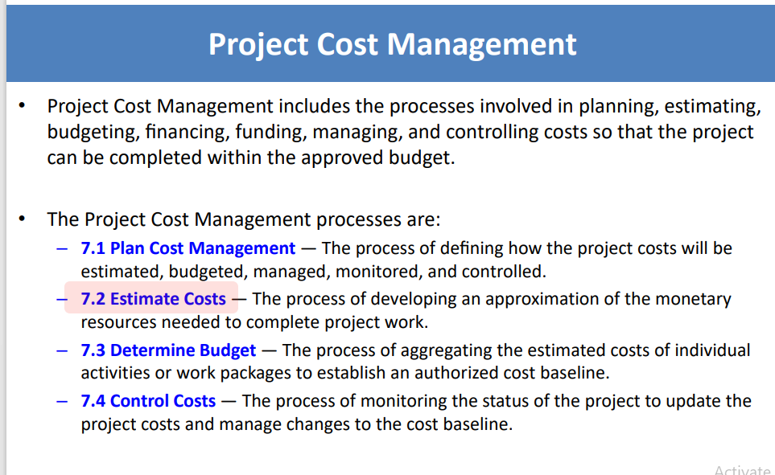
PROJECT COST MANAGEMENT

Slide 14
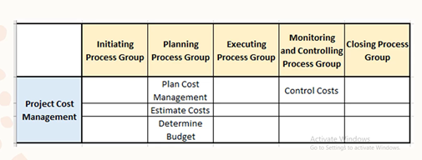

Slide 15
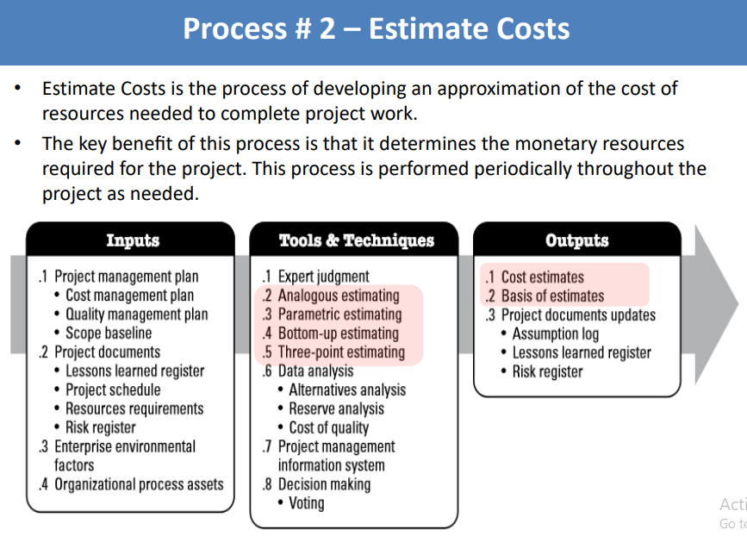
ESTIMATE COST

Slide 16
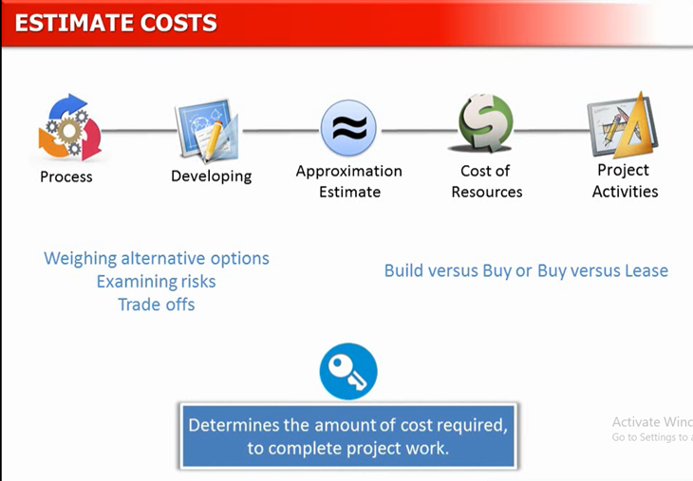

Slide 17
Cost Estimate
What Is a Cost Estimate?
A Cost estimate is a quantified expectation of how many resources are required to complete a project or parts of a project.
Such cost estimates are often expressed in currency units.

Slide 18
When Are Cost Estimated?
The PMBOK states that the process is performed “periodically throughout the project as needed”
Typically costs are estimated at different points in time throughout the project.
1- Initiation phase- e.g. when the project business case or the project charter is created. For these documents, a project manager has to determine the amount of resources that is required to complete the project.
As the information that is available at that point is usually not very detailed, the project manager will likely end up producing a rough order of magnitude estimate rather than a definitive estimate.
2- Planning Phase: Project when more information is available, this order of magnitude estimate will be replaced with a definitive estimate.
After the project initiation phase, the cost will be re-assessed during the planning phase.
3- In subsequent phases, costs are typically (re-)estimated if relevant new information and details become known ( iterative cycle) or if changes to the project scope or timeline occur (Monitoring & Controlling)
One of the common reasons for re-estimating cost is, for instance, when the indicators of the project controlling suggest that the original budget baseline cannot be met.

Slide 19
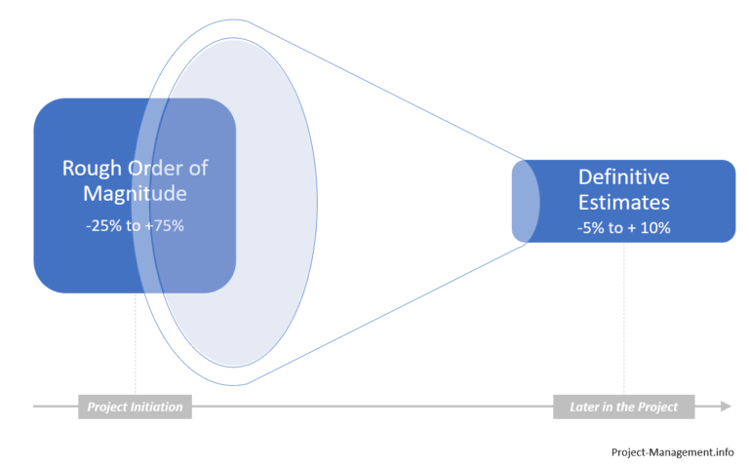
Types of Cost Estimates

Slide 20
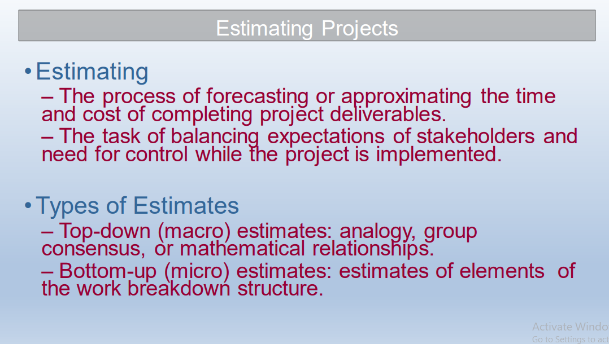
TYPE OF ESTIMATES

Slide 21
TOP DOWN VS BOTTOM UP ESTIMATES
Top-Down Estimates – usually are derived from someone who uses experience and/or information to determine the project duration and total cost. – are made by top managers who have little knowledge of the processes used to complete the project.
Bottom-Up Approach – can serve as a check on cost elements in the WBS by rolling up the work packages and associated cost accounts to major deliverables to the project level.

Slide 22
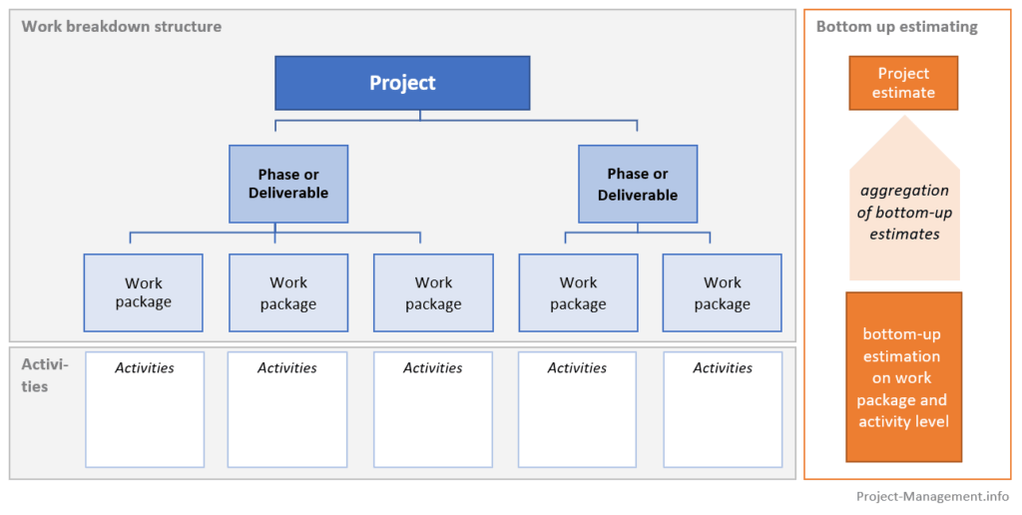
COST AGGREGATION:
BOTTOM UP APPROACH
While the estimation is performed at the level of activities or work packages, the estimate for the whole project is the sum of all granular estimates.

Slide 23
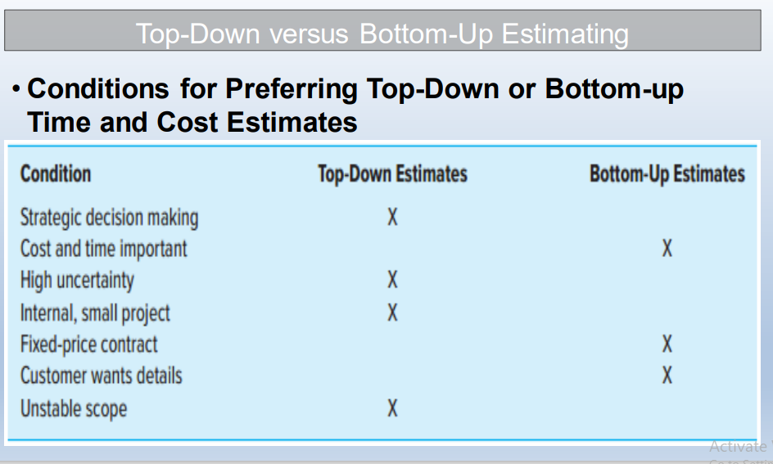
Top Down vs Bottom Up Estimates

Slide 24
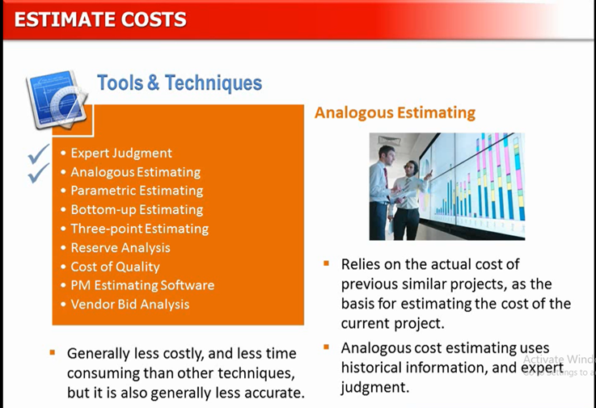

Slide 25
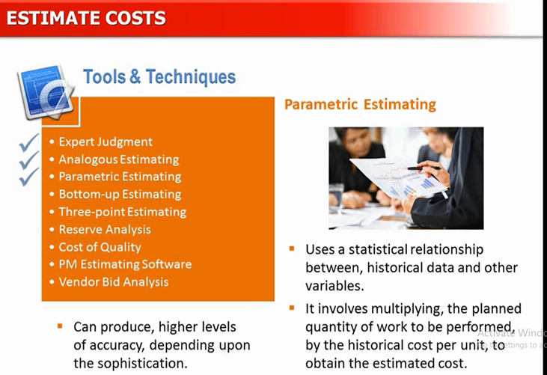

Slide 26
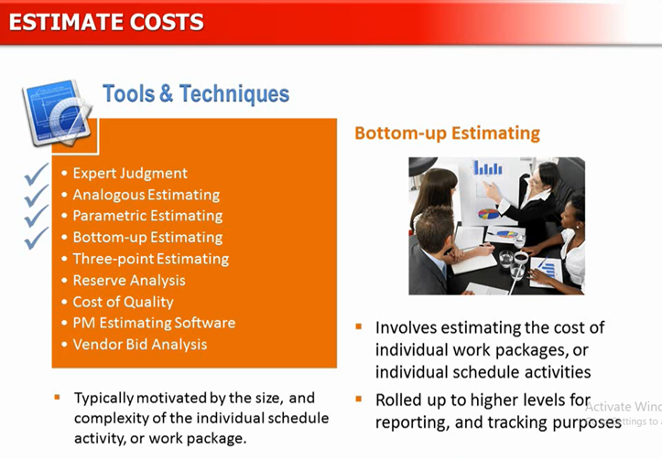

Slide 28
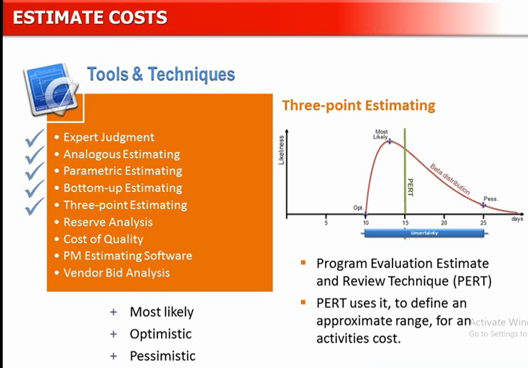

Slide 29
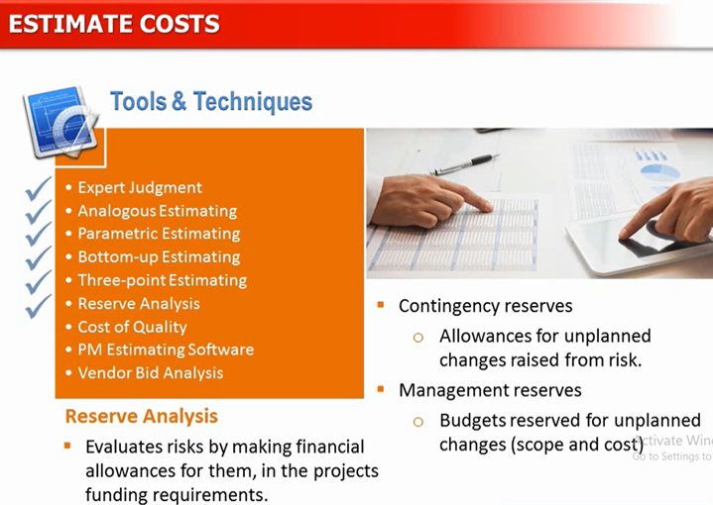

Slide 31
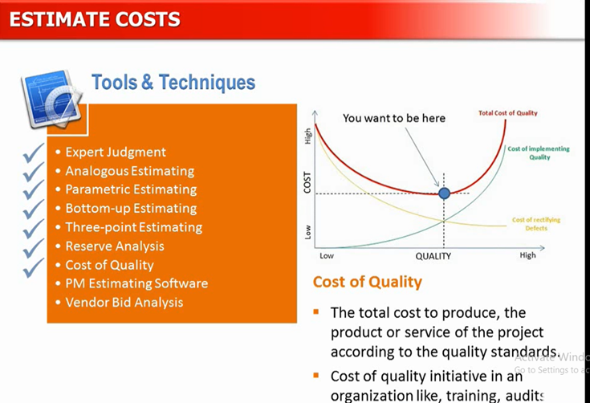

Slide 32
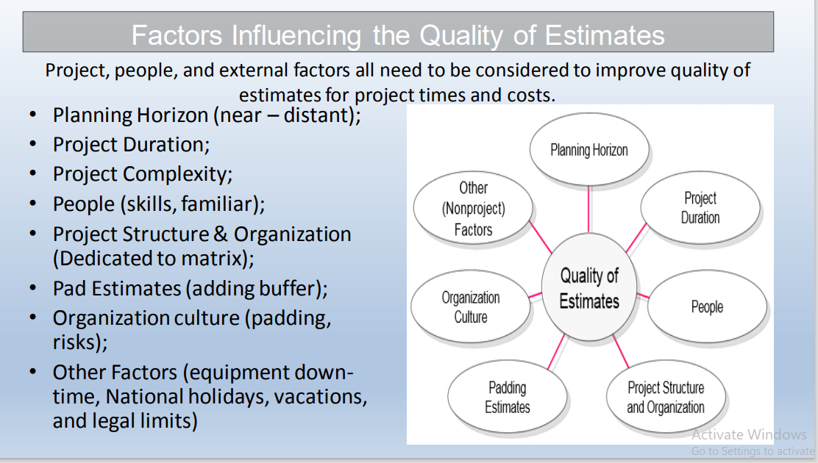
Factors influencing Quality of Estimates

Slide 33
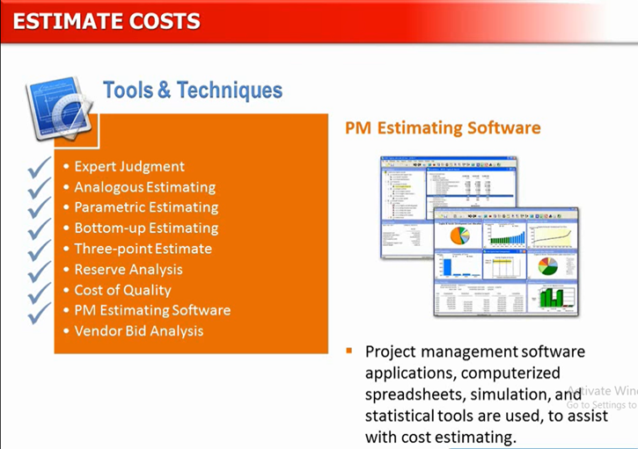

Slide 34
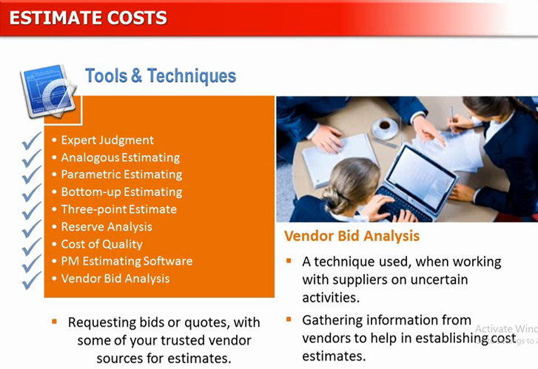

Slide 35
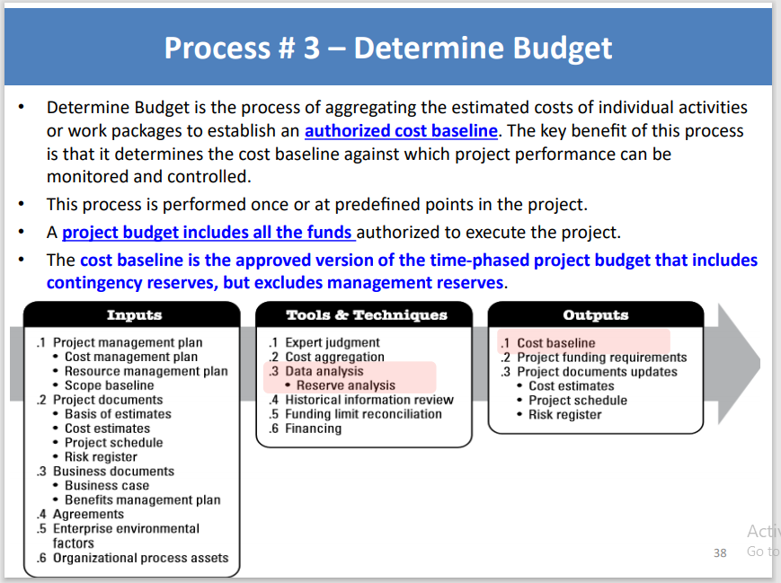
Process 3 Determine Budget

Slide 36
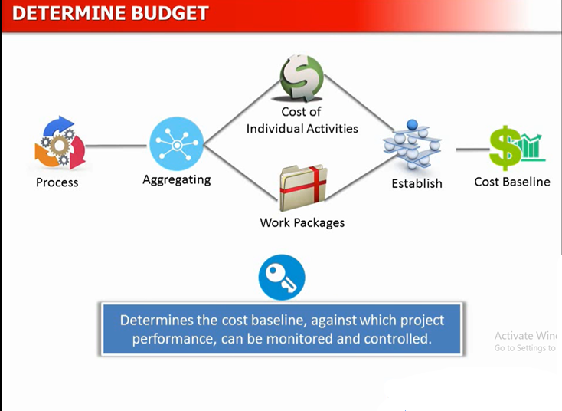

Slide 37
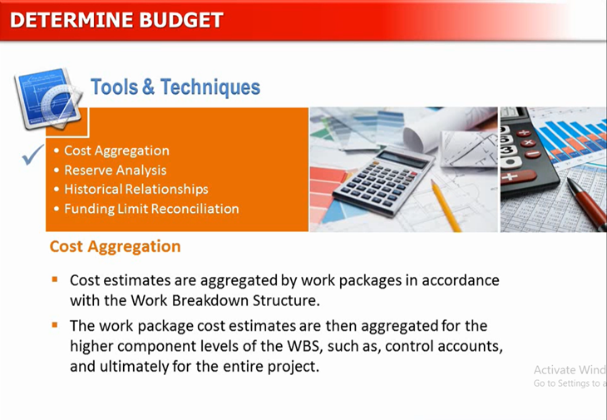

Slide 38
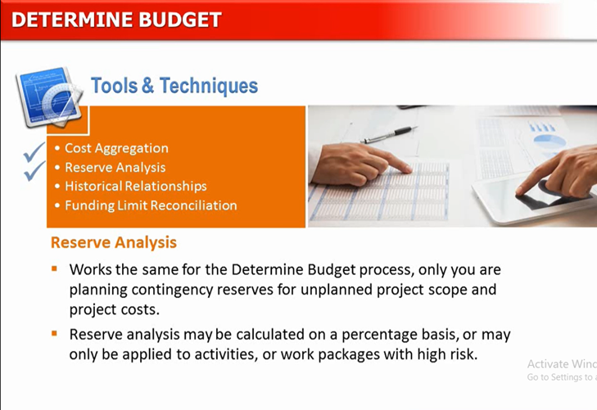

Slide 39
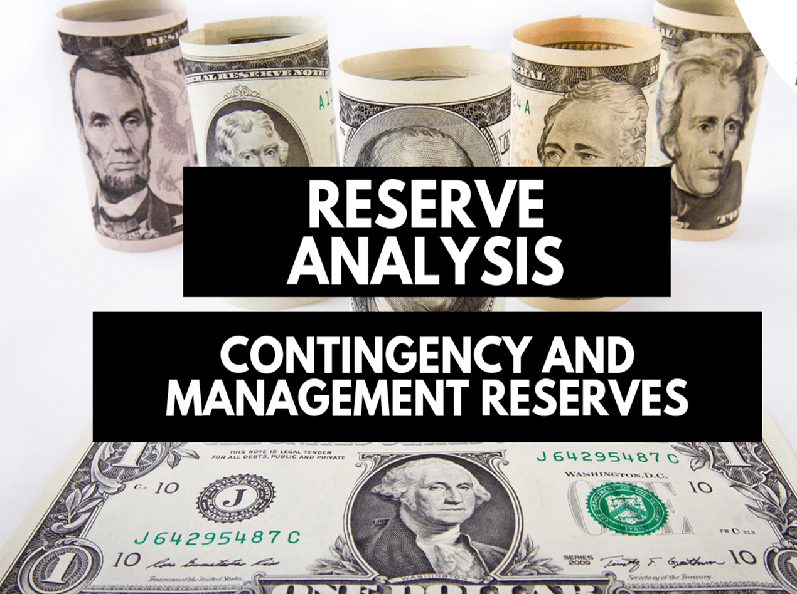

Slide 40
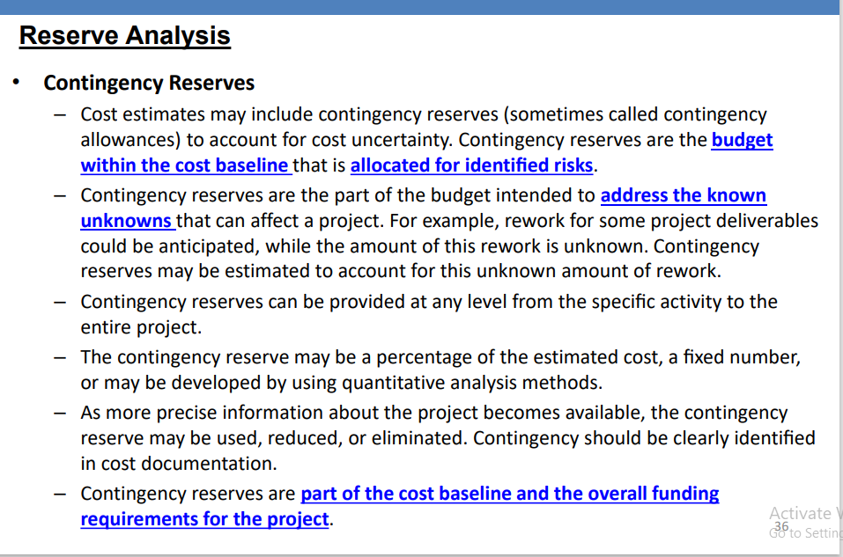
RESERVE ANALYSIS

Slide 41
RESERVE ANALYSIS
Contingency Reserve
The contingency reserve is not random; it is an estimated reserve based on various risk management techniques. Like, Percentage of the Project’s Cost, Expected Monetary Value, Decision Tree Analysis, Monte Carlo Simulation
Project managers control this reserve; they have full authority to use it whenever an identified risk occurs. They can also delegate this authority to a risk owner. The risk owner will manage it and update the project manager in later stages.

Slide 42
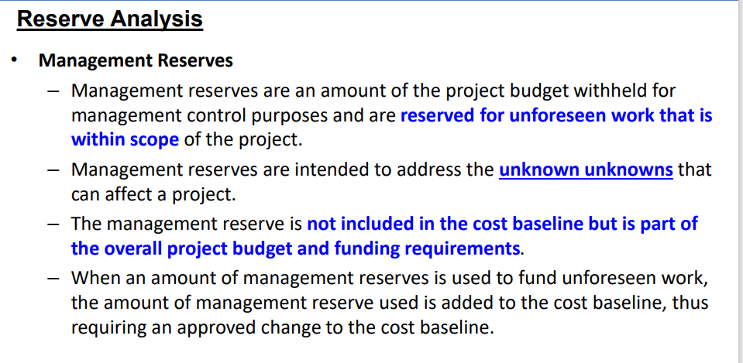
RESERVE ANALYSIS

Slide 43
RESERVE ANALYSIS
Management Reserve
The management reserve is a part of the project budget but not the cost baseline. It is not an estimated reserve; it is a figure that is fashioned according to the organization’s policies.
It can be 5% of the total project cost or duration of the project or it may be as high as 10%. The management reserve is usually estimated based on the uncertainty of the project.
For example, if you are doing a project in which your organization has the expertise and experience, the management reserve will be less. In this case, there is less uncertainty.
However, if you are doing a kind of project new to your organization, the management reserve will be high, because, in this situation, the uncertainty is greater.
The project manager does not control management reserve, the management does. Therefore, the project manager must receive approval to use this reserve whenever any unidentified risk occurs.

Slide 44
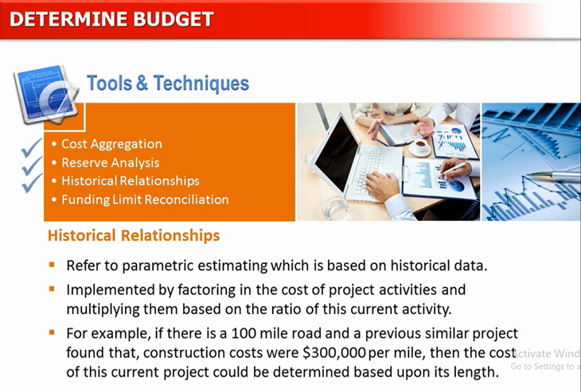

Slide 45
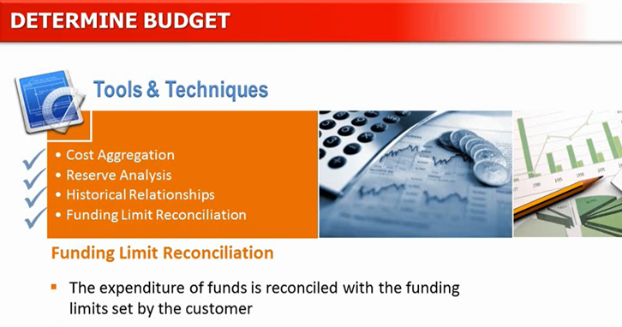

Slide 46
Cost Estimate
The cost estimate is the cost of all work packages and is “rolled up” to the top level; this is the total cost of the project.
Cost Baseline
When you add the contingency reserve to the cost estimate, you get the cost baseline.
Cost Baseline = Cost Estimate + Contingency Reserve
Note that the project’s performance will be measured against the cost baseline.
Project Budget
If you add the management reserve to the cost baseline, you will get the project budget.
Project Budget = Cost Baseline + Management Reserve

Slide 47
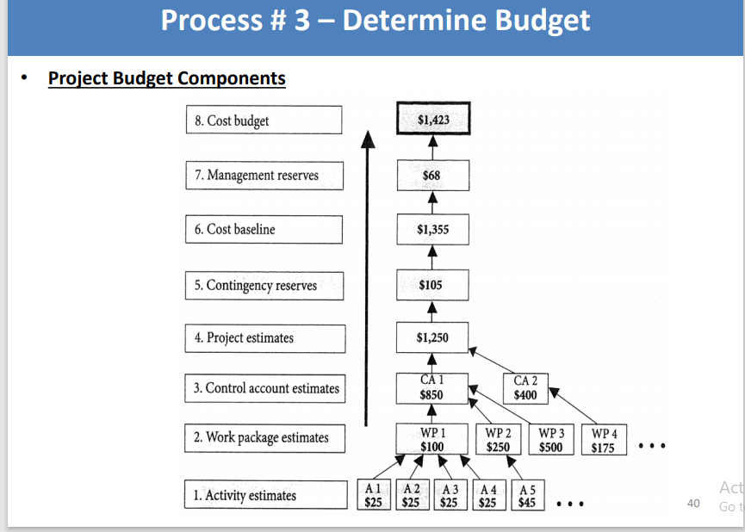

Slide 48
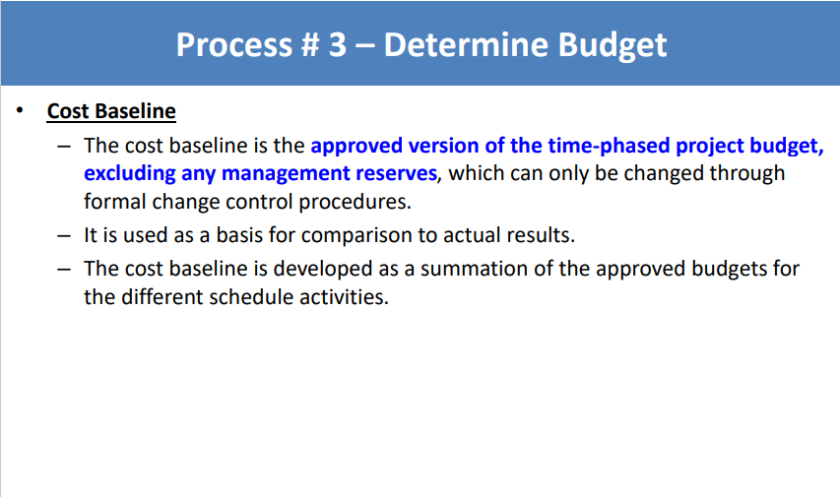
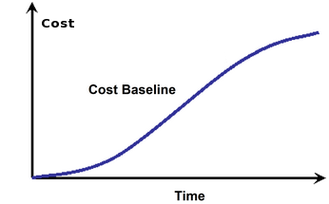
COST BASELINE

Slide 49
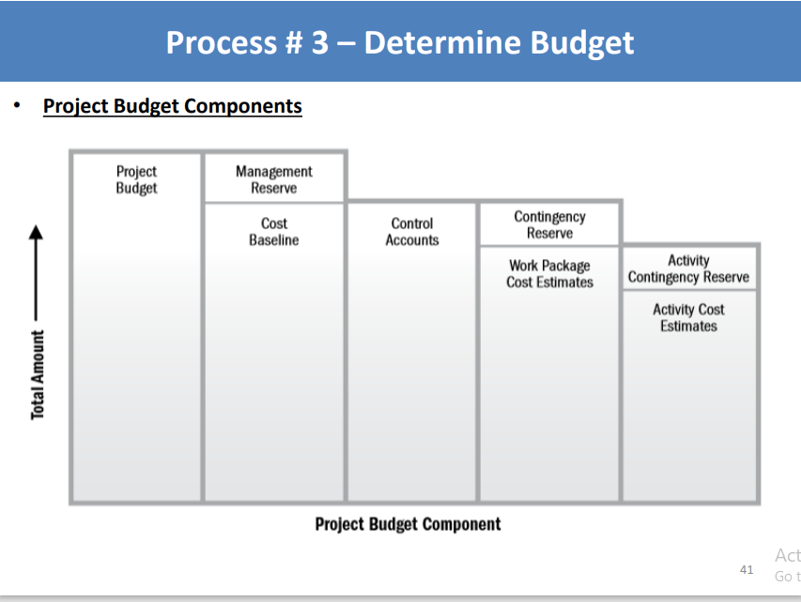

Slide 50
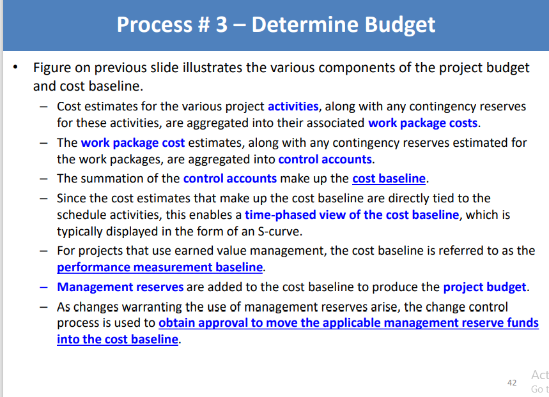

Slide 51
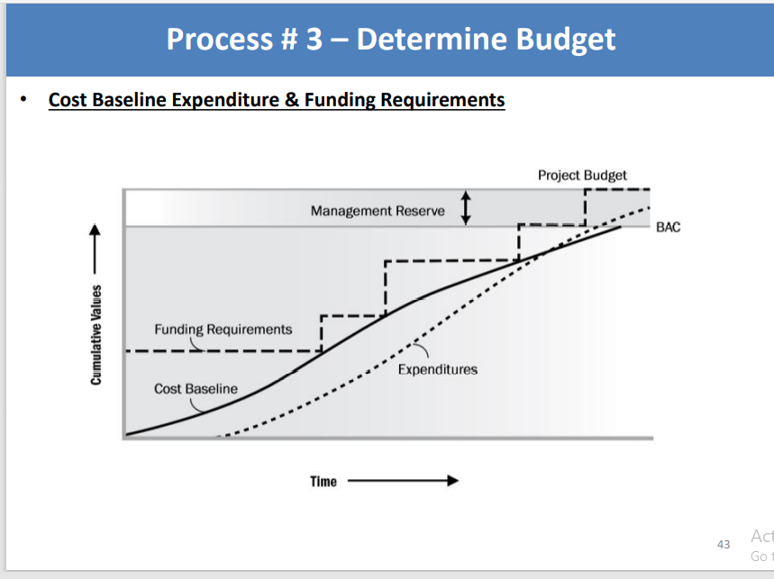

Slide 52
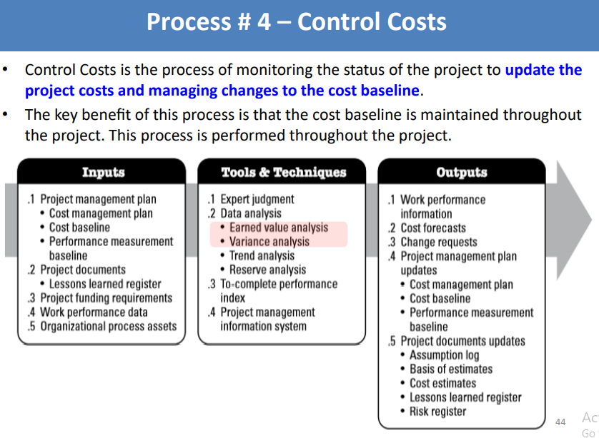

Slide 53
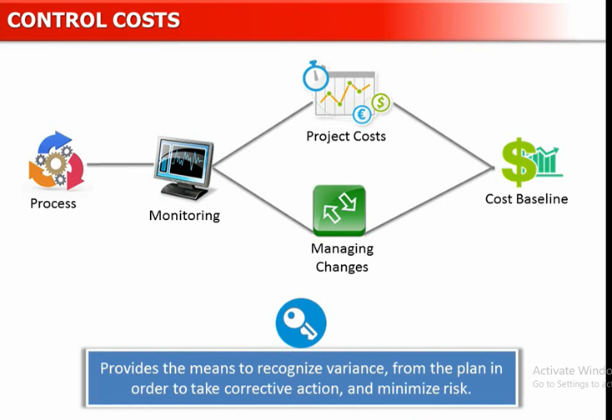

Slide 54
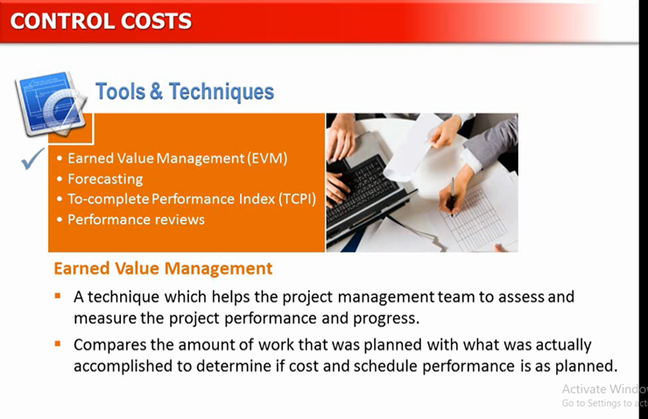

Slide 55
